Slide 1


SofTMech – Digital Twins of the Heart
Dr Vinny Davies

Slide 2

SofTMech Centre
The SofTMech Centre (http://www.softmech.org/) is a Centre of Mathematics for Healthcare at the University of Glasgow
The Centre consists of multiple academic, clinical and industrial partners and combines extensive expertise in mathematical, statistical and computational modelling of cardiac physiology and disease.
SofTMech: Centre for Multiscale Soft Tissue Mechanics - with application to heart & cancer (EP/N014642/1)
SofTMech^MP: SofTMech with MIT and POLIMI (EP/S030875/1)
SofTMech^SET: The SofTMech Statistical Emulation and Translation Hub (EP/T017899/1)
The Centre develops mathematical models of the heart combined with statistical inference techniques with applications to heard conditions and beyond

Slide 3

The Goal of the SofTMech Centre
The aim is to model complex systems of the heart etc through complex mathematical models
Practically these models are often highly complex, so statistical inference methods are needed to make applicable in a clinically relevant time frame
By inferring the parameters of the models, it is hoped that personalised diagnoses and treatments might be possible in the future

Slide 4
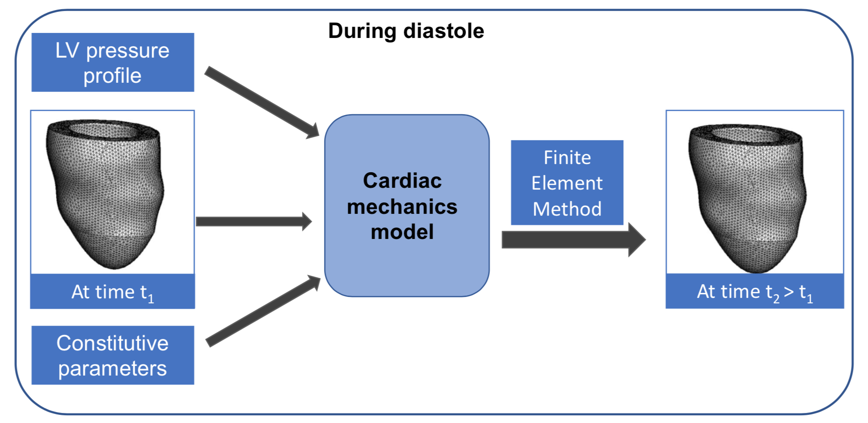
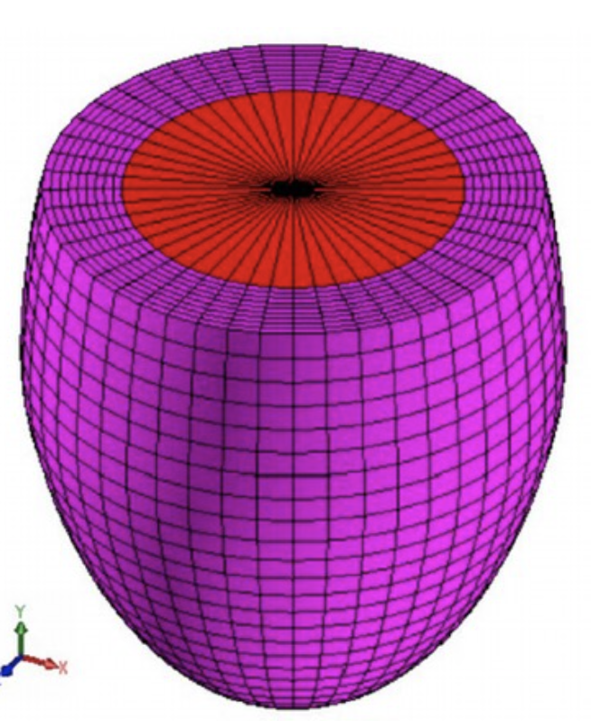
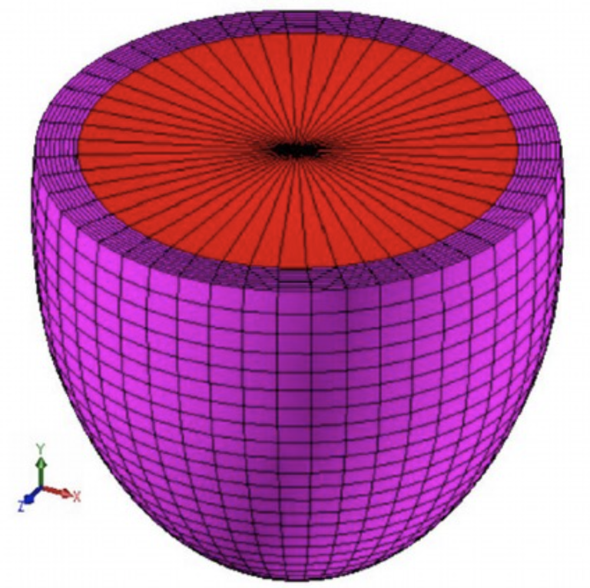
An Example in Cardiac Mechanics
Cardiac Mechanics Digital Twin

Slide 5
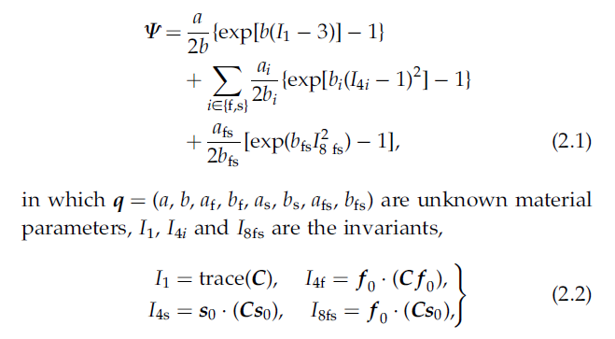
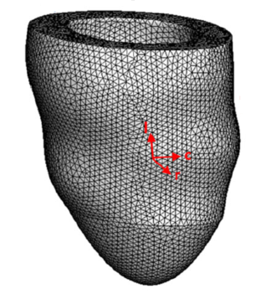
An Example in Cardiac Mechanics
Model of Left Ventricle movement given by Holzapfel & Ogden Constitutive Law

Slide 6
An Example in Cardiac Mechanics
Cardiac Mechanics Digital Twin

Slide 7
An Example in Cardiac Mechanics
Cardiac Mechanics Digital Twin

Slide 8

An Example in Cardiac Mechanics
Cardiac Mechanics Digital Twin

Slide 9
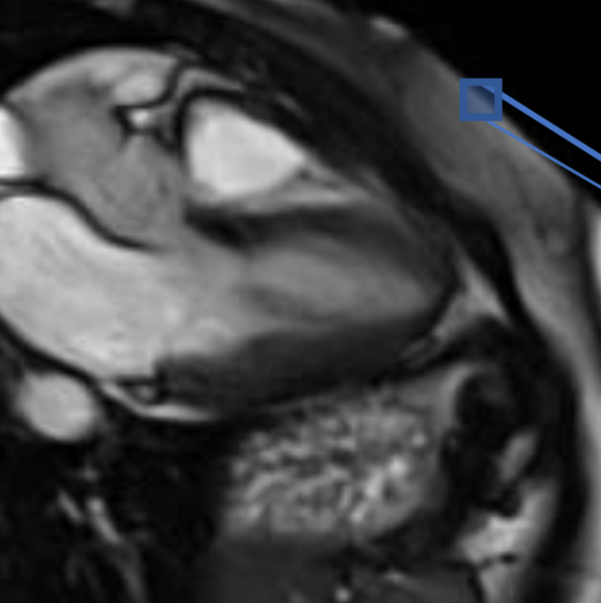
An Example in Cardiac Mechanics
Cardiac Mechanics Digital Twin

Slide 10
An Example in Cardiac Mechanics
Cardiac Mechanics Digital Twin

Slide 11

An Example in Cardiac Mechanics
Cardiac Mechanics Digital Twin
Compare and minimise the difference to learn parameters

Slide 12
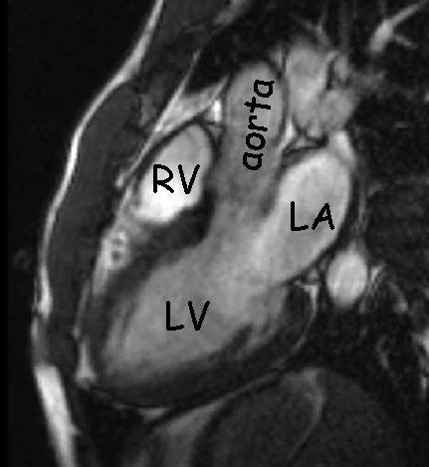
An Example in Cardiac Mechanics
In this sense, the mesh (left) combined with mathematical model acts as a digital twin of the real heart (right)
We can do inference on the digital twin without touching the actual heart

Slide 13
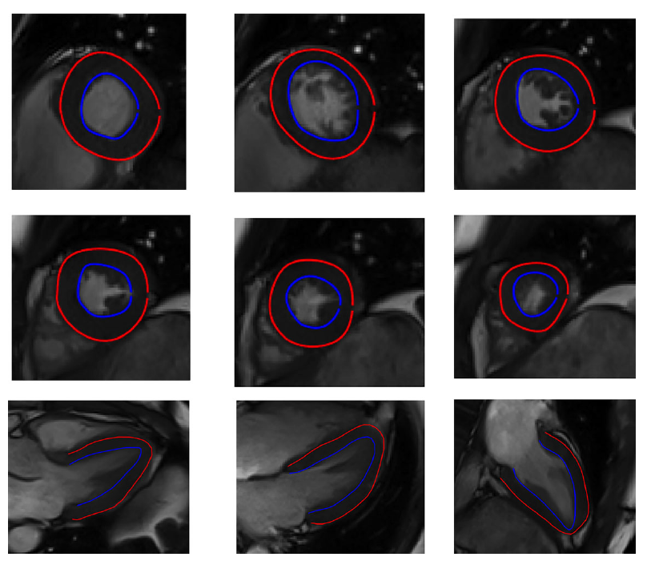
An Example in Cardiac Mechanics
Data is linked to the digital twin through annotated MRI scans
The annotations left, are used to create the 3D mesh of the left ventricle

Slide 14

An Example in Cardiac Mechanics
There are problems with the approach and this is where statistical emulation comes in
Inference using the mathematical digital twin can take 1 day – not useful for heart attacks!
We can use emulation to make a cheap digital twin of the expensive mathematical digital twin!
Real
World
Mathematical
Digital Twin
Statistical
Digital Twin

Slide 15

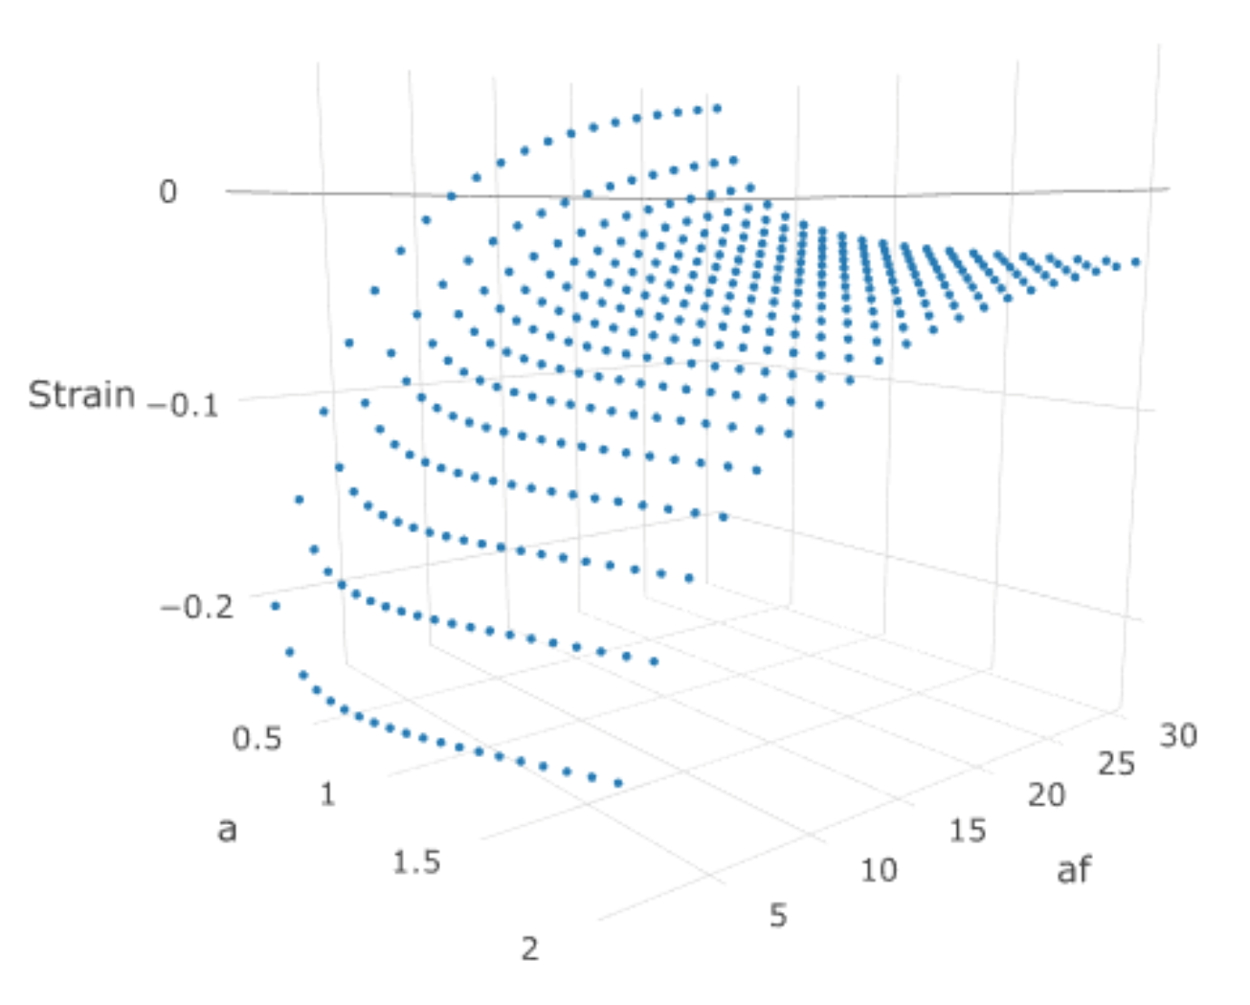
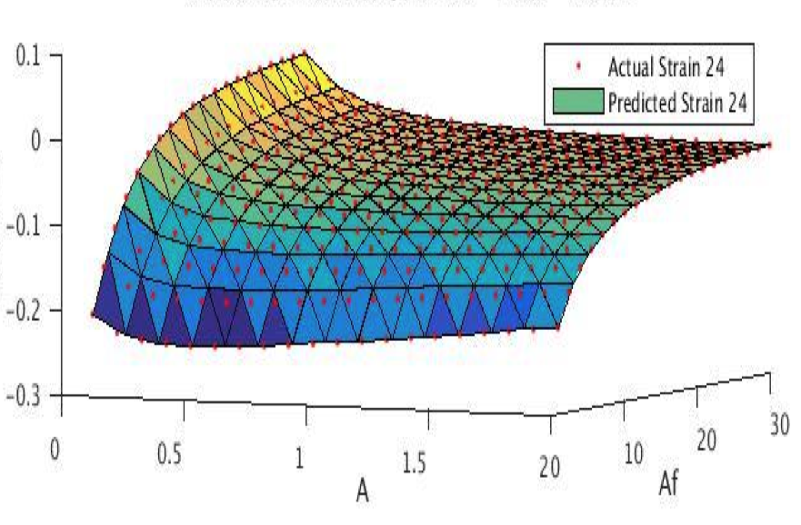
An Example in Cardiac Mechanics
Parallel processing
Model outputs
Parameters
Model outputs
Statistical nonlinear interpolation
with GPs
Parameters

Slide 16
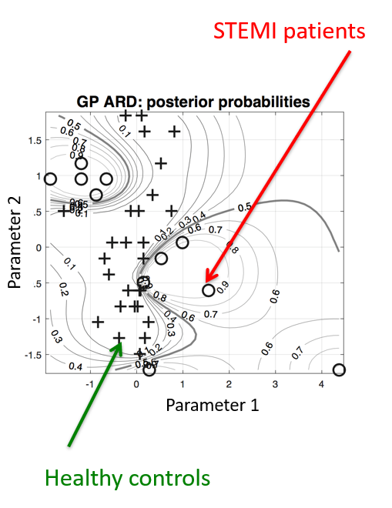
An Example in Cardiac Mechanics
Fast inference is possible using the statistical digital twins
Limitations remain in terms of making the digital twins effective for new patients
Opens up the possibility of personalised treatment and diagnosis going forward

